Slide 1

IPL Data Visualization
CS661 Project
Group 16

Slide 2
Introduction
Cricket was deeply embedded in India's culture, and the Indian Premier League (IPL) revolutionised the game by bringing together international and domestic players in a fast-paced T20 format.
Over the years, the IPL produced thrilling contests, remarkable individual performances, and intense rivalries, making it one of the most followed cricket leagues in the world.
Each match generated extensive data, and analysing these statistics provided valuable insights into team performances, player consistency, and tournament trends.
Our project aimed to leverage this vast dataset to create an interactive and insightful data visualisation system.

Slide 3
Data Source
The dataset is sourced from the Kaggle IPL Complete Dataset (2008–2024), originally compiled by Cricsheet.
It includes two CSV files: matches (match summaries) and deliveries (ball-by-ball details).
The data covers match results, team stats, player performances, and trends across IPL seasons, enabling in-depth analysis.
Link to kaggle dataset
15
Teams
17
Seasons
732
Players
1095
Matches

Slide 4
Tech Stack
Backend (Data Processing & APIs)
Python (Flask) handles server-side operations.
Data preprocessing (cleaning, feature generation) done with Python scripts.
Precomputed aggregates saved as JSON/CSV for fast data access.
Provides API endpoints for data and predictions.
Frontend (Visualization & Interaction)
D3.js creates dynamic, interactive charts and dashboards.
Features include drill-downs (e.g., player stats on click), tooltips, zoom, and smooth transitions for a great UX.

Slide 5
Key Tasks
Data Preprocessing
Collected data from IPL match records, ball-by-ball events, and player statistics across seasons.
Cleaned the dataset to remove inconsistencies such as missing player names, team name variations, and erroneous entries.
Standardized data formats for dates, player IDs, and team abbreviations to ensure consistency.

Slide 6
Key Tasks
Feature Engineering: Extracted important cricketing metrics from raw data, such as
Developed a cricket-specific points system for batting, bowling, and fielding contributions (based on runs, wickets, maidens, strike rate, economy rate, etc.).
Batting strike rate = (Runs Scored / Balls Faced) × 100
Bowling economy rate = (Runs Conceded / Overs Bowled)
Win/Loss ratios for each team, etc.

Slide 7
Key Tasks
Data Visualization Development: Designed interactive and dynamic visual representations using D3.js:
Developed frontend pages using Flask + D3.js for:
Stats Dashboard
Team Stats (matches, wins, losses)
Player Stats (individual records and comparisons)
Season Stats (matches per year, general trends)
Contests (team head-to-head comparisons)
Win Prediction Dashboard

Slide 8
Key Tasks
Plotted
Bar Charts for team performances.
Line Graphs for player progression over seasons.
Word Cloud for showcasing top 25 players based on average points.
Built a clean and responsive dashboard to host all visualizations, ensuring smooth transitions and interactions.

Slide 9
Key Tasks
Insights Generation
Identified patterns and trends such as:
Best-performing players per season and career.
Impact players for specific venues or conditions.
Team strengths when batting first versus chasing.

Slide 10
Key Tasks
User Interaction & Filtering
Implemented filter options:
By Season: View stats from specific IPL editions.
By Player: Deep dive into any player’s career performances.
By Team: Analyze individual team history and performance.
Users can dynamically filter and drill down into any visualization to personalize their analytics experience.

Slide 11
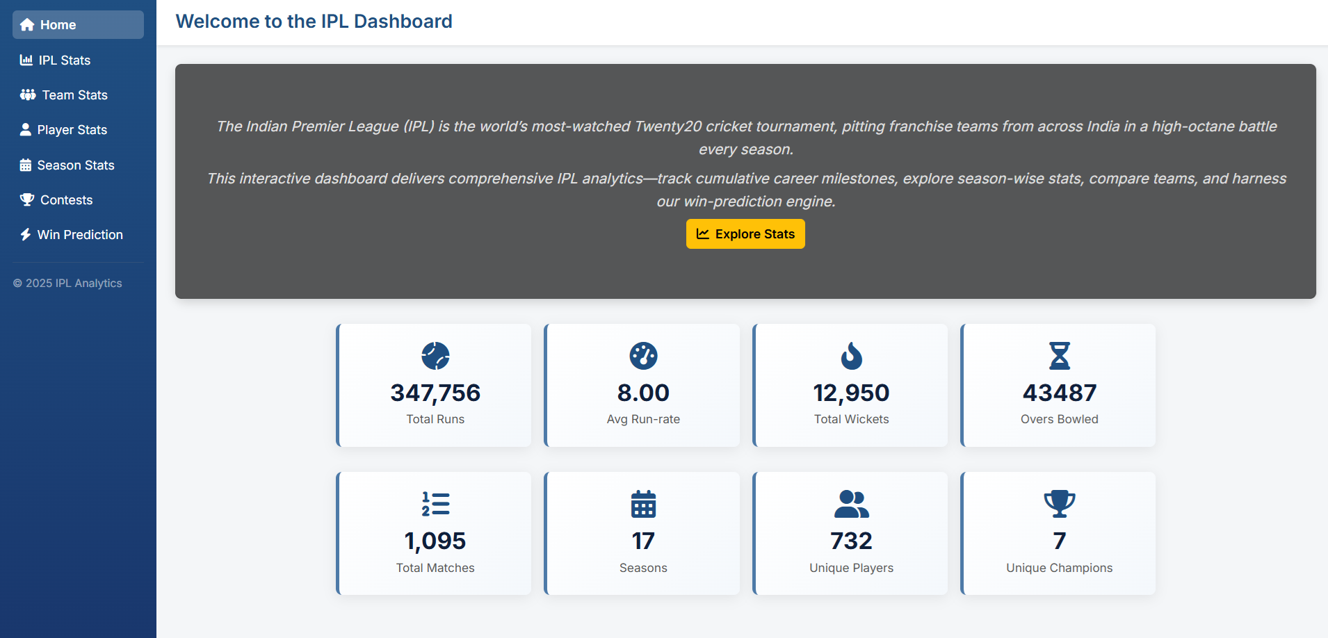
Visualizations - Dashboard

Slide 12
Visualizations - Individual Player Stats
Many metrics were used to analyse and visualise individual player performance.
Batting metrics: Runs, balls faced, dismissals, 4s, 6s, strike rate, batting avg
Bowling Metrics: Wickets, balls, overs, runc conceded, economy etc.
Fielding Metrics: Fielding attempts
Seasonal Metrics
Strike Rate_{season} = (Runs_{season}/Balls Faced_{season} )× 100
Economy_{season} = Runs Conceded_{season}/Overs_{season}
Dismissal Modes: Batting dismissals, Bowling dismissals

Slide 13
Visualizations - Top 25 Players
Batting metric
Batting_points = runs + (fours × 4) + (sixes × 6)
Bowling metric
Bowling_points= dot balls × 1 + wickets × 30 + lbw bowled × 8
Fielding metric
Fielding_points = catches×8 +(catches ≥ 3)×4 + stumpings×12 + run outs × 6
Career Average Points = total match points/ total matches

Slide 14
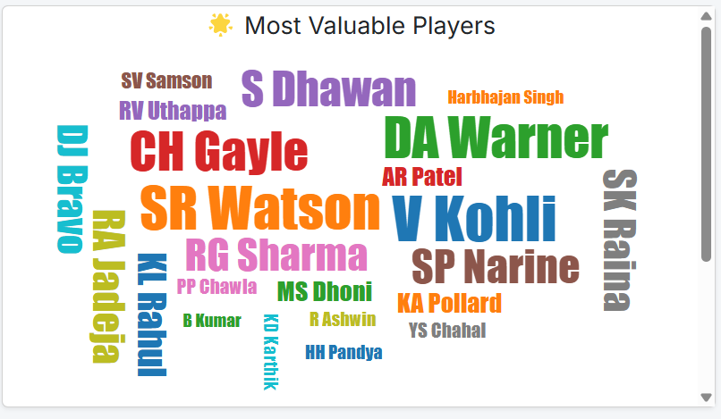
Visualizations - Top 25 Players

Slide 15
Visualizations - Season Stats
Orange Cap (Top Batsman by Runs), Purple Cap (Top Bowler by Wickets)
Season Summary
Total sixes
Total fours
Total dot balls
Average Innings Score = Total Runs over all Innings/No. Of Innings
Average Wickets per Match = Total Wickets over all Matches / No. of Matches

Slide 16
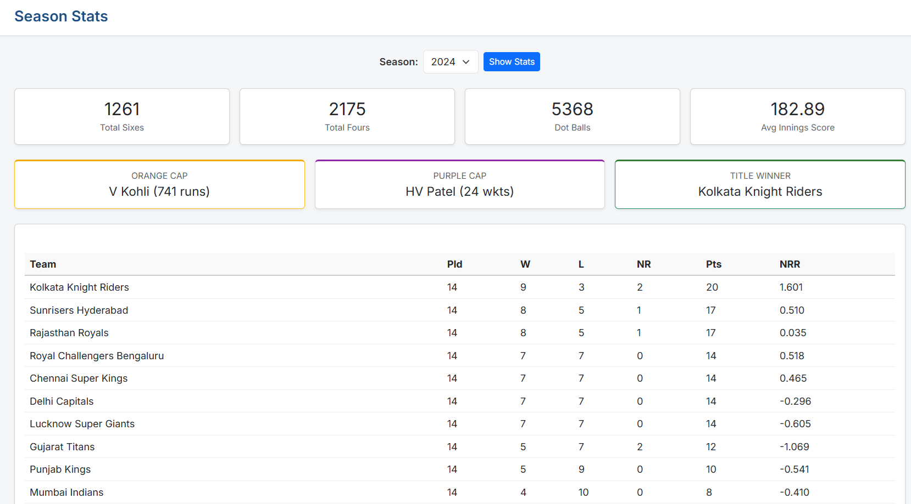
Visualizations - Season Stats

Slide 17
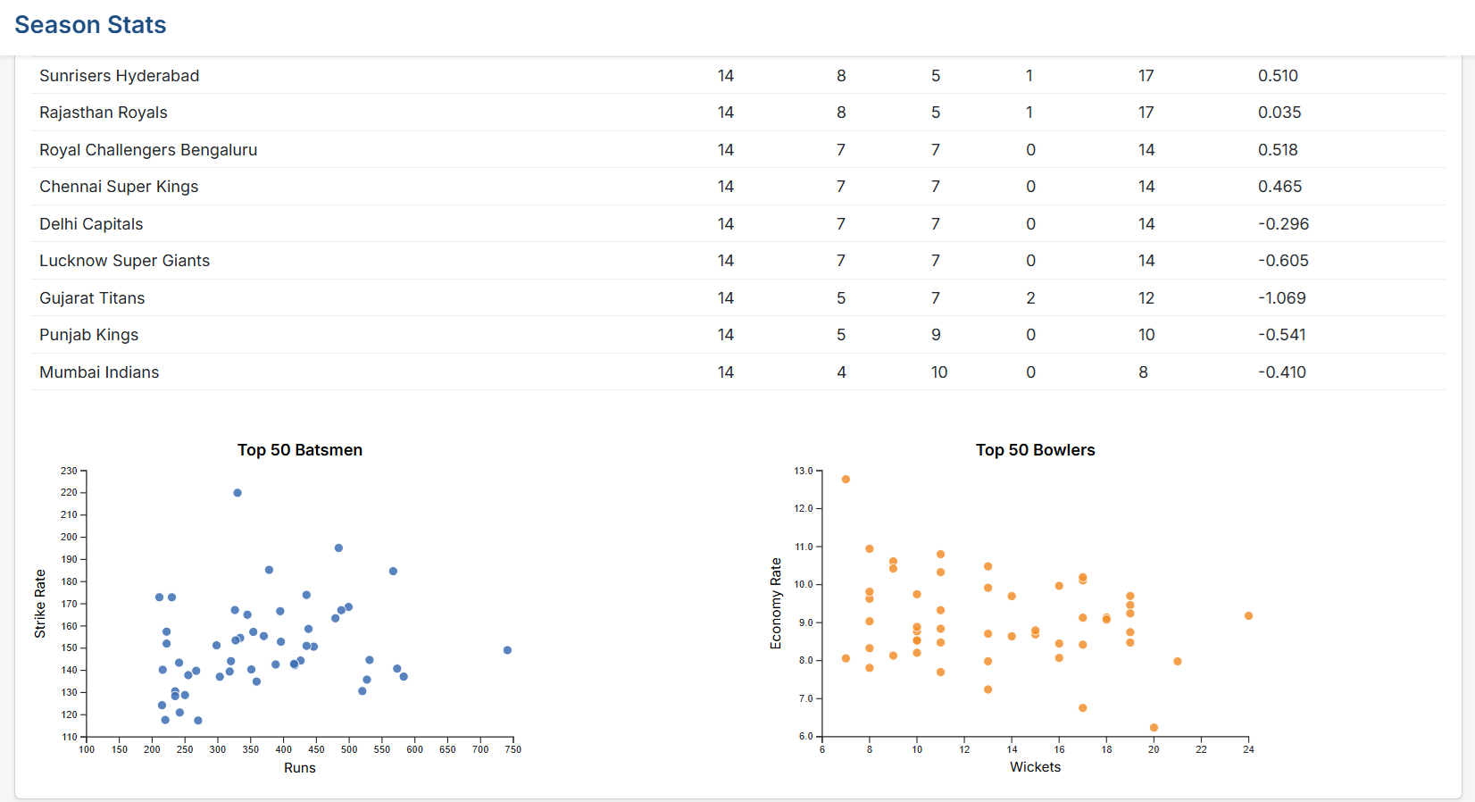
Visualizations - Season Stats

Slide 18
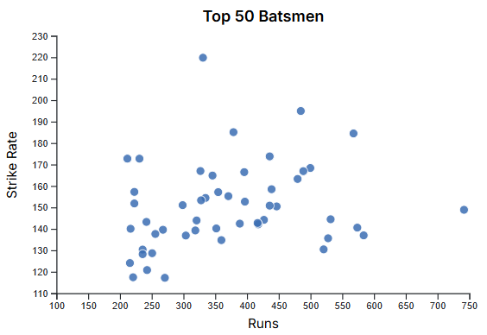
Visualizations - Season Stats
Batsmen Scatter Plot
Top 50 batsmen based on their runs across selected seasons
Strike Rate = (Total Runs / Balls Faced) × 100

Slide 19
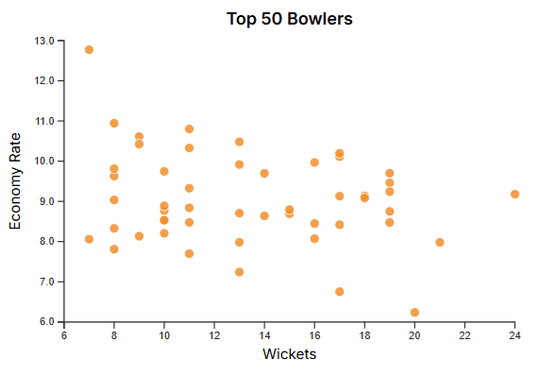
Visualizations - Season Stats
Bowlers Scatter Plot
Top 50 bowlers based on their wickets across selected seasons
Economy Rate = (Runs Conceded/Balls Bowled ​)×6

Slide 20
Visualizations - Team Stats
Overall Team Stats
Matches played, no. of wins, losses, no results, home stats, away stats
Head to Head Stats
Total Matches, Wins for Team A, Wins for Team B, No Result, Home Stats for Team A, Home Stats for Team B
Team Overview
Top 5 run scorers and wicket takers, Top 5 successful chases and defenses

Slide 21
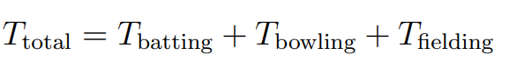
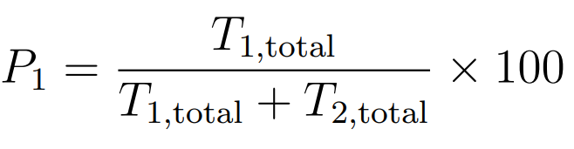
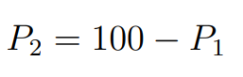
Win Prediction
Player scores are calculated based on batting, bowling, and fielding performances using detailed metrics.
Team score is the sum of all player scores across batting, bowling, and fielding.
Win probability is estimated by comparing both teams' total scores using a simple ratio formula.

Slide 22
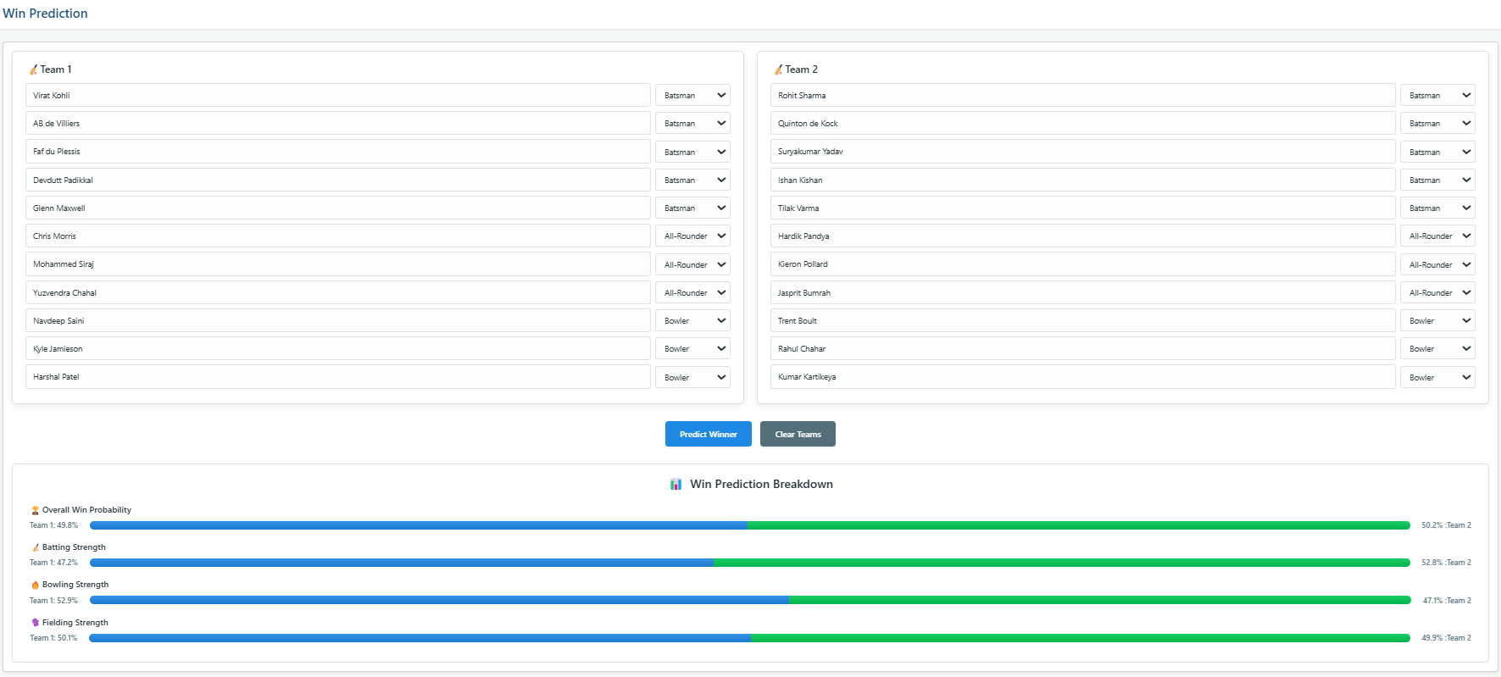
Win Prediction

Slide 23
Conclusion
This project enables the cricket analysts, fans, and enthusiasts to explore data-driven insight using interactive visualisation techniques. Our system offers engaging, intuitive, and meaningful representations of IPL data trends over the years.

Slide 24
Thank you!
Group 16 - Team Members
1. Aman Kumar (210110, kaman21@iitk.ac.in)
2. Ashish Meena (210214, ashishm21@iitk.ac.in)
3. Palak Mishra (210690, palakm21@iitk.ac.in)
4. Paturi Bhavya (210712, paturib21@iitk.ac.in)
5. Sandhan Aniket Ramdas (210924, sandhanar21@iitk.ac.in)
6. Siddheshwari Madavi (211036, srmadavi21@iitk.ac.in)
7. Somya Gupta (211049, somyavg21@iitk.ac.in)

